Slide 1


Mike Sullivan – Solid Waste and Contaminated Sites Supervisor
Iowa Department of Natural Resources Update
2025 Iowa Recycling & Solid Waste Management Conference
Coralville, IA
October 1, 2025

Slide 2
PUBLIC NONDISCRIMINATION
Federal and State law prohibit discrimination on the basis of age, color, creed, mental and/or physical disability, national origin, pregnancy, race, religion, sex, sexual orientation or gender identity. If you believe you have been discriminated against in any program, activity or facility as described above, or if you desire further information, please contact the Iowa Civil Rights Commission at 800-457-4416 or DNR’s Civil Rights Coordinators at civilrights@dnr.iowa.gov.
Notes:
NOTE FOR DNR STAFF: Use this statement for course registration, course materials, or exam-preparation materials for DNR licenses and certifications related to programs with no U.S. Fish & Wildlife Service funding (e.g. entirely state funding or other federal funding). The statement should also be used in presentations provided for continuing education credit. Other uses of the statement are optional.
DNR is legally required to include a nondiscrimination statement in materials and publications related to educational programs and activities. You may format the statement as needed but communicate with DNR’s external civil rights coordinator, Rachel Zander, regarding text changes or with questions.
Please log all uses of this statement in this tracking form.

Slide 3
DNR Update
Budget
Staffing
Rulemaking Update (Executive Order 10)
Programmatic Updates
Solid Waste Tonnage Fee Summary

Slide 4
Budget
FY2026 Discretionary Budget Request
Elimination of ~ $1 billion in grants to states.
Elimination of 19 out of 22 categorical grant programs under the State and Tribal Assistance Grants (STAG) account.
Federal Government Shutdown and Appropriation Process
Solid Waste Tonnage Fees Not Impacted by Federal Appropriations
DNR Travel
DNR Hiring

Slide 5
Staffing
Vacancies
Environmental Engineer (x2) – Mick Leat and Geoff Spain
Environmental Specialist Senior – Sue Johnson
Program Planner 3 – Laurie Rasmus
GIS Section Supervisor – Kathryne Clarke
Executive Officer 3 – Tim Hall
Other LQB, WQB, AQB, and FSCB Vacancies
Interim Assignments
Plans for Filling Positions

Slide 6
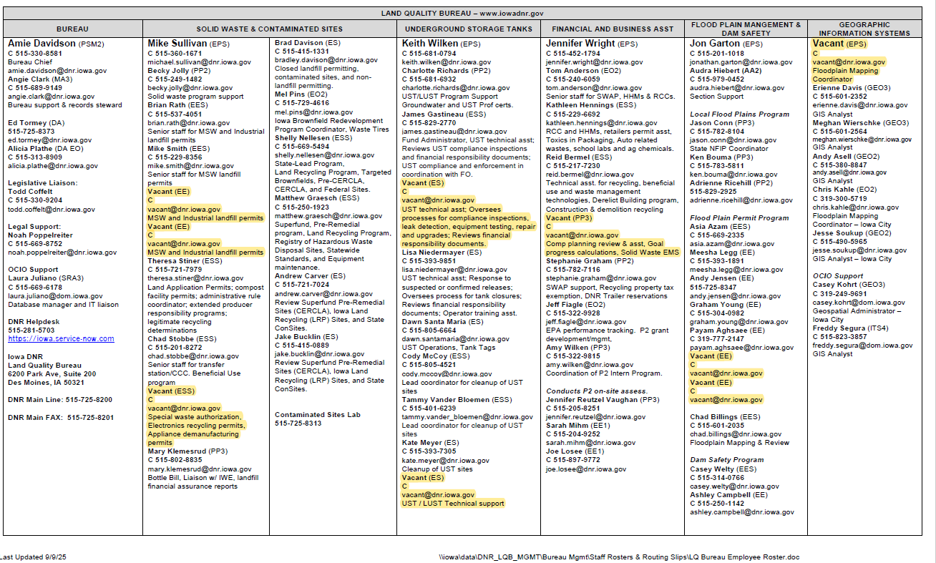
Staffing

Slide 7
Rulemaking Update (EO10)
Hearing Dates/Times
October 7, 2025 for Solid Waste and Contaminated Sites (via Zoom)
October 8, 2025 for FABA (via Zoom)
Additional Schedule
Environmental Protection Commission Fall 2025 (Notice of Intended Action).
Two (2) Hearings in January 2026.
Environmental Protection Commission Spring 2026 (Adopted and Filed)
Effective (~June 2026)
Update of Application Forms, Reporting Forms, Website, Guidance Documents, etc.
LQB Metrics for Success (UST, FABA, and Solid Waste and Contaminated Sites)
127,000+ Fewer Words
131 Fewer Rules
3,000+ Fewer Restrictive Terms
Equally Protective of Environment and Public Health

Slide 8
Rulemaking Update (EO10) (cont.)
Chapter 100: Authority, Definitions, and General Permitting Requirements
All definitions and other rules that apply to all SW chapters have been moved to this chapter. Other chapters incorporate these rules by reference.
ERRAP has been streamlined to focus on operations since DNR does not have the authority to regulate health and safety.

Slide 9
Rulemaking Update (EO10) (cont.)
Chapter 101: Sanitary Disposal Projects
Division I: Landfill-Specific Requirements
Division II: Municipal Solid Waste Landfills
Division III: Industrial Landfills
Division IV: Coal Combustion Residual Landfills
Division V: Solid Waste Transfer Stations
Division VI: Solid Waste Incinerator Operator Certification
Division VII: Reserved
Division VIII: Financial Assurance
FA C/PC Account Requirement for Industrial Landfills.

Slide 10
Rulemaking Update (EO10) (cont.)
Chapter 101: Sanitary Disposal Projects (cont.)
Industrial Landfill Permit Period Increasing from three (3) to five (5) years.
CCCs Changed to Transfer Stations, Opportunity to Streamline Process.
Pursue Rescission of SW Incinerator Operator Certification.

Slide 11
Rulemaking Update (EO10) (cont.)
Chapter 102: Solid Waste Management
Division I: Organic Materials Composting Facilities
Division II: Land Application of Waste
Division III: Landfarming of Petroleum Contaminated Soil
Division IV: Beneficial Use
Division V: Waste Tire Management
Division VI: Special Waste Authorizations
Division VII: Discarded Appliance Demanufacturing
Division VIII: Cathode Ray Tube Recycling
Compost Rules Underwent Significant Revisions with Workgroup. New Chapter Regulates Composting on Volume and Feedstock Type.

Slide 12
Rulemaking Update (EO10) (cont.)
Chapter 103: HHW and RCC
Chapters 123 and 211 were reviewed consistent with EO10.
Chapters 123 and 211 will be rescinded and necessary language placed in Chapter 103.
Purpose of Chapter 103 is to implement financial and operating license requirements for Regional Collection Centers (RCCs) and satellite facilities, which provide for the collection and proper disposal of household hazardous materials and hazardous waste from very small quantity generators.

Slide 13
Rulemaking Update (EO10) (cont.)
Chapter 104: Solid Waste Comprehensive Planning and Environmental Management System Requirements
Chapters 101 and 111 were reviewed, simplified, and consolidated consistent with EO10.
Chapters 123 and 211 will be rescinded and necessary language placed in Chapter 104.
Purpose of Chapter 104 is to provide direction and clarity for comprehensive planning and environmental management system requirements and criteria.

Slide 14
Rulemaking Update (EO10) (cont.)
Chapter 105: Hazardous Conditions
Chapters 131, 133, and 137 were reviewed, simplified, and consolidated consistent with EO10.
Chapters 131, 133, and 137 will be rescinded and necessary language placed in Chapter 105.
Slight Changes to Reporting Hazardous Conditions in Division I. Spills of less than 25 gallons of petroleum products and less than 100 pounds of anhydrous ammonia are exempt from reporting.
Action Level under Division II (MCLs Instead of HALs)

Slide 15
Rulemaking Update (EO10) (cont.)
Chapter 107: Beverage Container Deposits
Chapter 107 was reviewed consistent with EO10.
Rulemaking is limited to implementing EO10 by removing outdated and duplicative language.
Chapter 109: Landfill Alternatives Financial Assistance Programs
Chapter 209 was reviewed consistent with EO10, removing language that is unnecessary, redundant, and duplicative.
Chapters 209 will be rescinded and necessary language placed in Chapter 109.

Slide 16
Rulemaking Update (EO10) (cont.)
Rescissions
Chapter 119: Used Oil and Used Oil Filters.
Chapter 145: Household Batteries.
Chapter 149: Fees for Transportation, Treatment and Disposal of Hazardous Waste.
Chapter 152: Criteria for Siting Low-Level Radioactive Waste Disposal Facilities.
Chapter 213: Packaging – Heavy Metal Content.

Slide 17
Programmatic Updates
Special Waste
Special Waste Authorization Requests Reminders: 1) Signed by Both Generator and Landfill; 2) Attach Documentation and Discuss the Basis for Waste Determination; 3) Include your Special Waste Acceptance Criteria (SWAC).
Non-Special Waste Inquiries
Iowa DNR is not authorized to implement RCRA Subtitle C (Hazardous Waste). EPA Region 7 is responsible for compliance with RCRA Subtitle C.
Landfills
Groundwater Separation and Underdrains: Development of technical framework to allow landfills to make requests to not require groundwater separation in new cells or to shut off existing underdrains. More to come on this.
Pause on SOP Development
Extended Turnaround Times
Notes:
Thanks for meeting with us last week to continue our discussion on this topic. As we mentioned, we have had ongoing internal DNR discussions regarding groundwater separation and groundwater underdrains. Specifically, we are working on the technical framework to allow landfills to make a request to not require the groundwater separation in new cells or to shut off existing underdrains. When the current Chapter 113 rules were written, we knew that we could not eliminate the separation requirement completely, as some conditions and situations necessitate groundwater underdrains. However, we added language that allowed for lesser or no separation if the conditions and situations warranted it. And there have been a few landfills that have requested this in various forms.
Further, with up to 18 years of data, with maybe one exception, groundwater impact at MSW landfills is associated with unlined areas or sometimes clay-lined cells. At this point, we believe this allowance will be on a case-by-case basis. And, for situations that still need to manage groundwater during construction and to prevent uplift of the liner until sufficient ballast (waste) is in place, dewatering systems may be required. Nonetheless, this has the potential for substantial cost savings to landfills.
We are planning to finalize the guidance yet this fall, and encourage you to consider shutting down your underdrains as an option. It should be noted that if a landfill successfully demonstrates that their hydrologic setting does not necessitate groundwater separation but still need to manage groundwater during construction, that a facility will need to work with the DNR’s NPDES Section to determine the applicable permit.
As to the current operations at Dickinson, the Solid Waste and Contaminated Sites Section has determined that the underdrains (i.e. holding pond) shall continue to be monitored semi-annually as we can't ignore our landfill rules for determining contamination. Therefore, you will need to:
1) Continue to sample the holding pond semi-annually for Appendix I parameters and statistically evaluate for the presence of Statistically Significant Increases (SSIs) over background.
2) If an SSI is present, the discharge must be collected and treated as leachate. The facility will need to work with the DNR's NPDES Section or a city sewage treatment plant to determine disposal options.

Slide 18
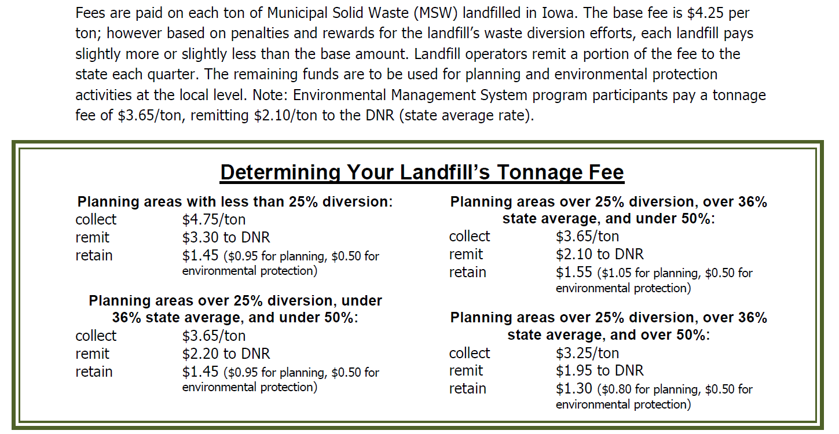
Solid Waste Tonnage Fees

Slide 19
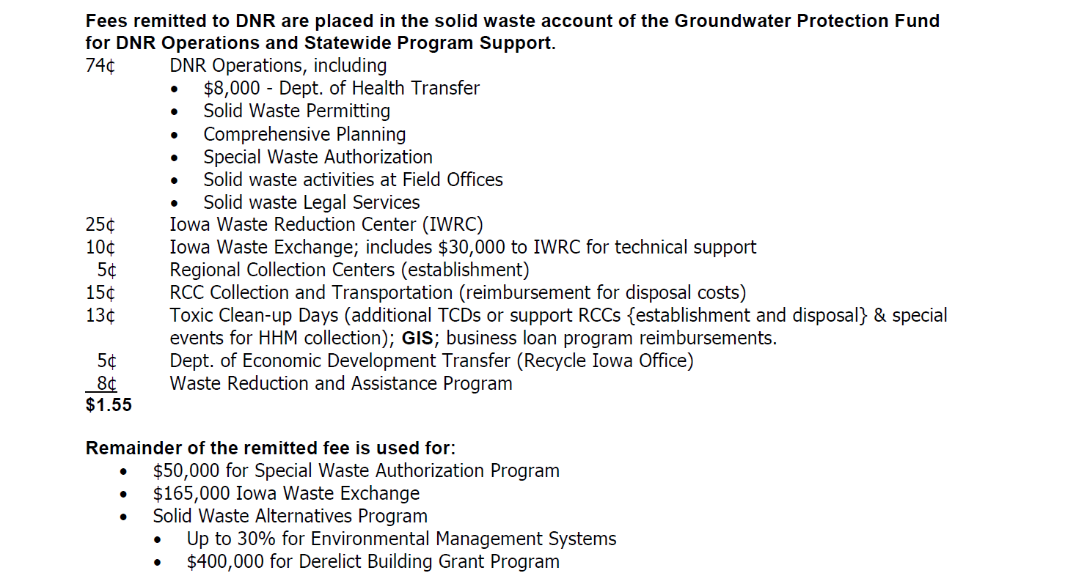
Solid Waste Tonnage Fees

